Slide 1
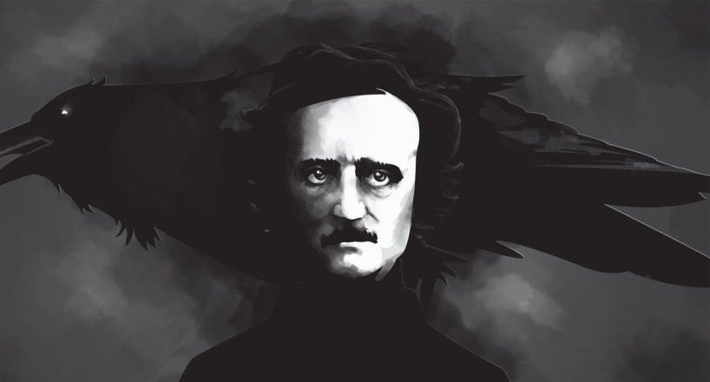
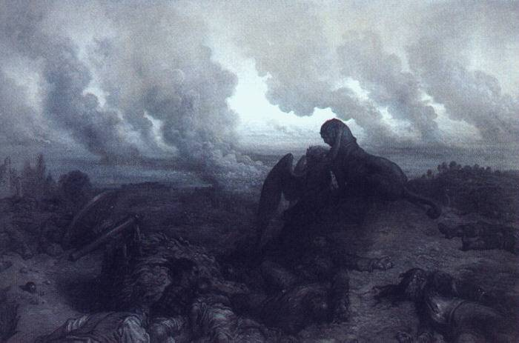
Anti-Transcendentalism
Jessica Aguigui ∙ Young Han ∙ Kristianna Mortera
Maricel Santos ∙ Michael Sison ∙ Kurtis Silva ∙ Jade Scott
·Pilar Righetti

Slide 2
What is Anti-Transcendentalism?
19th Century
Focused and believed in:
Dark side of humanity
Individual Truths
Man’s uncertainty and limitations in universe
Potential Destructiveness of the human spirit.

Slide 3
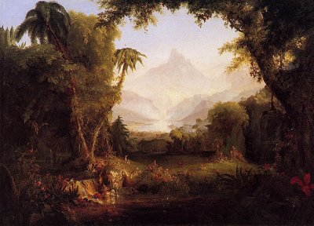
What is Anti-Transcendentalism?
Reasons/Causes:
Opposed optimism and naïve idealism
Discontented with American circumstances
Focused on moral dilemmas and ills.

Slide 4
What is Anti-Transcendentalism?
View of Nature:
Vast and incomprehensible
Is a reflection of the struggle between good and evil.
Is a creation and possession of God and cannot be understood by human beings.

Slide 5
Anti-Transcendentalist Writers:
Nathaniel Hawthorne
Herman Melville
Edgar Allan Poe
Characteristics of their stories:
Supernatural
Not Spiritual
Evil
Pain

Slide 6
Anti Transcendentalist Writing Style
Includes Man vs. Nature conflicts
Raw and morbid diction
Prevalent use of symbolism.
Focuses on protagonist’s inner struggles
Haunted outsiders alienated from society

Slide 7
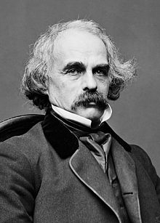
Nathaniel Hawthorne
American writer from Salem, Massachusetts
July 4, 1804 – May 19, 1864
Family name “Hathorne”
Spent younger years writing and reading
First collection failed at publication
Wrote “The Scarlet Letter” and more

Slide 8
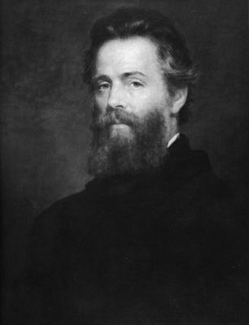
Herman Melville
Poet, Short Story/Novel/Fiction Writer
August 1, 1819 – September 28, 1891
Loved reading various types of books
Greatly influenced from travelling on sea.
Most famous novel is “Moby Dick,”
Fame from “Moby Dick” came posthumously.

Slide 9
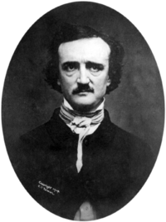
Edgar Allan Poe
January 19, 1809-October 7, 1849
American poet and short story writer.
Released a book while in army.
Writing career falls into three periods.
Works include “The Tell-Tale Heart” and “The Raven”
Influenced Charles Baudelaire and Jules Vurne.

Slide 10
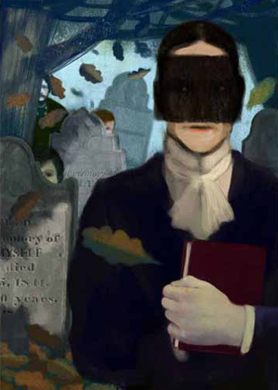
The Minister’s Black Veil by Nathaniel Hawthorne
Village gathers to hear Hooper’s sermon
Hooper is seen wearing a veil.
Hooper always wears the black veil.
The people start to neglect him.
They’re alarmed by his questionable behavior.
He never removed the veil.

Slide 11
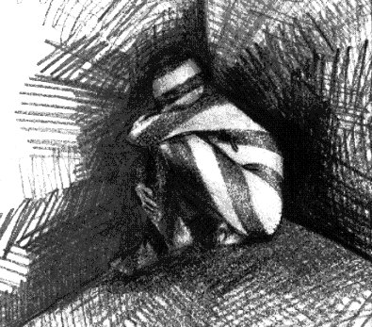
The Minister’s Black Veil Analysis
Theme: Alienation and Loneliness.
Genre: Suspense or Mystery
Black Veil Symbolism
Includes:
Allegory
Mood

Slide 12
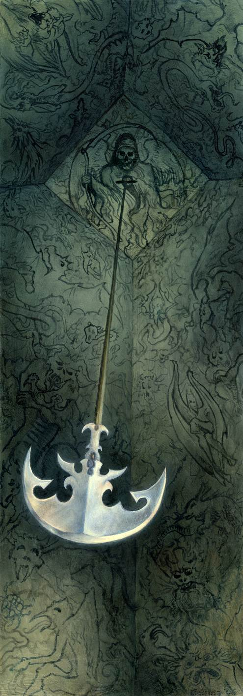
The Pit and the Pendulum by Edgar Allan Poe
Narrator is brought to trial
Narrator wakes up in a cell
Goes through various obstacles
Narrator is rescued by French Army.

Slide 13
The Pit and the Pendulum Analysis
Genre: Science Fiction/Gothic Short Story
Themes:
Similarity of love and hate
Rivalry between self and alter ego.

Slide 14
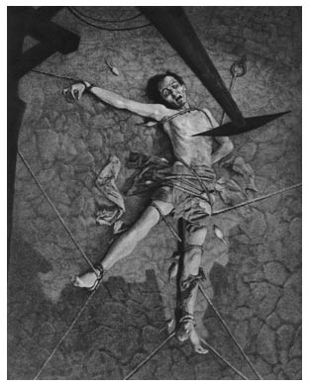
The Pit and the Pendulum Analysis
Includes:
Foreshadowing
Repetition
Imagery
Hyperbole
Metaphors

Slide 15
Works Cited:
Ahearne, Tammy. "Antitranscendentalism." Antitranscendentalism. N.p., 11 Feb. 2009. Web. 11 Dec. 2012. <http://www.slideshare.net/ahearnet/antitranscendentalism>.
Doty, Phoebe. "The Evolution of Hawthorne." ENGL 299 | Intro to English Studies. College of Charleston Blogs, 19 Sept. 2011. Web. 10 Dec. 2012. <http://blogs.cofc.edu/seamanm-engl299-f11/tag/the-ministers-black-veil/>.
Teuber, Andreas. "Edgar Allan Poe Biography." Edgar Allan Poe Biography. Library & Technology Services, Brandeis University, n.d. Web. 10 Dec. 2012. <http://people.brandeis.edu/~teuber/poebio.html%20>.
"Edgar Allan Poe Biography." Edgar Allan Poe BiographyThe European Graduate School: Graduate and Postgraduate Studies, n.d. Web. 11 Dec. 2012. <http://www.egs.edu/library/edgar-allan-poe/biography/>.

Slide 16
Works Cited:
"Nathaniel Hawthorne - Biography." Nathaniel Hawthorne. The European Graduate School: Graduate and Postgraduate Studies, n.d. Web. 11 Dec. 2012. <http://www.egs.edu/library/nathaniel-hawthorne/biography/>.
"Herman Melville Biography." Herman Melville Biography. N.p., n.d. Web. 04 Dec. 2012. <http://people.brandeis.edu/~teuber/melvillebio.html>.
Helms, Sherry. "Herman Melville and Moby-Dick: An Unpopular Author and His World Popular Literature â Printsasia." Herman Melville and MobyDick An Unpopular Author and His World Popular Literature Comments. N.p., n.d. Web. 04 Dec. 2012. <http://blog.printsasia.com/2012/10/18/herman-melville-and-moby-dick-an-unpopular-author-and-his-world-popular-literature/>.
"Poe’s Short Stories Key Facts." SparkNotes. SparkNotes, n.d. Web. 11 Dec. 2012. <http://www.sparknotes.com/lit/poestories/facts.html>.

Slide 17
Images Cited.
Dore, Gustaave. The Enigma. 1871. JPG.
Woo-Bang, Min. Dark Forest. 2009. JPG.
Cole, Thomas. The Garden of Eden. 1828. JPG.
Brady, Matthew. Nathaniel Hawthorne. c. 1860-1865. JPG.
Eaten, Joseph O. Herman Melville. 1944. JPG.
Manchestar, Edwin H. Herman Melville. 1904. JPG.
Rota, Laura. The Minister’s Black Veil. 2009. JPG.
Sabu. Alienation Nightmare. 1996. JPG.
Collins, William. The Pit and the Pendulum. 2002. JPG.
Mortensen, William. The Pit and the Pendulum. 1935. JPG.

